Slide 1

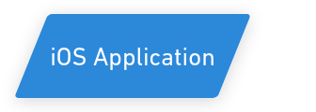

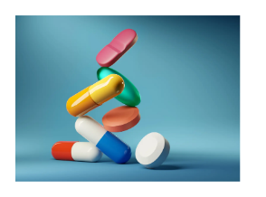
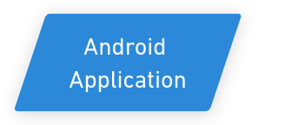
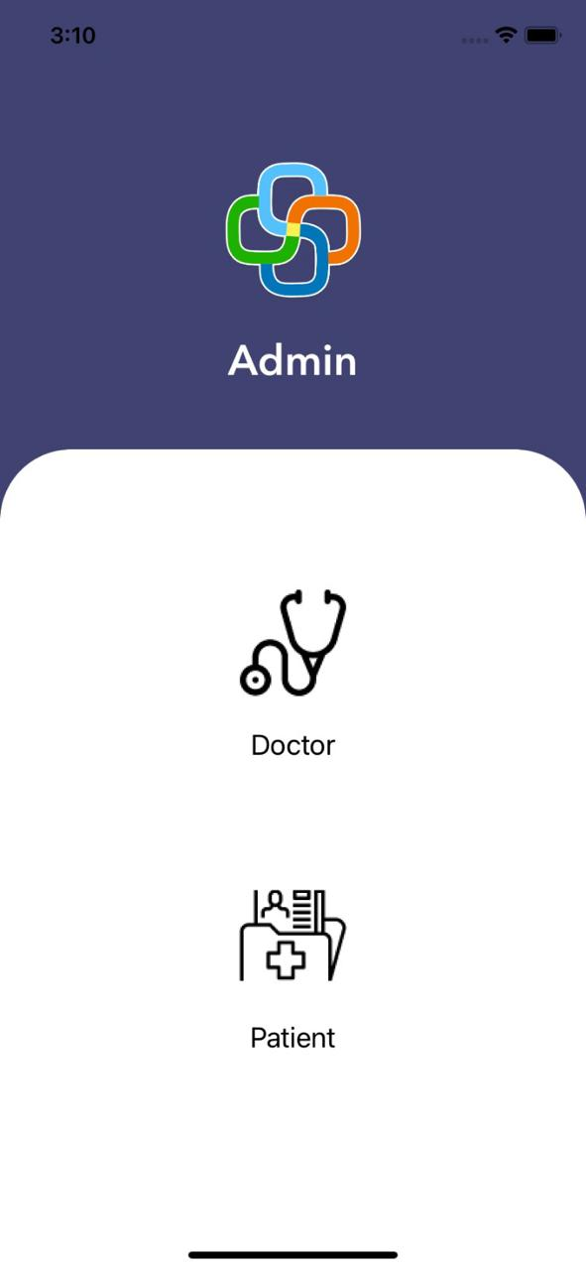
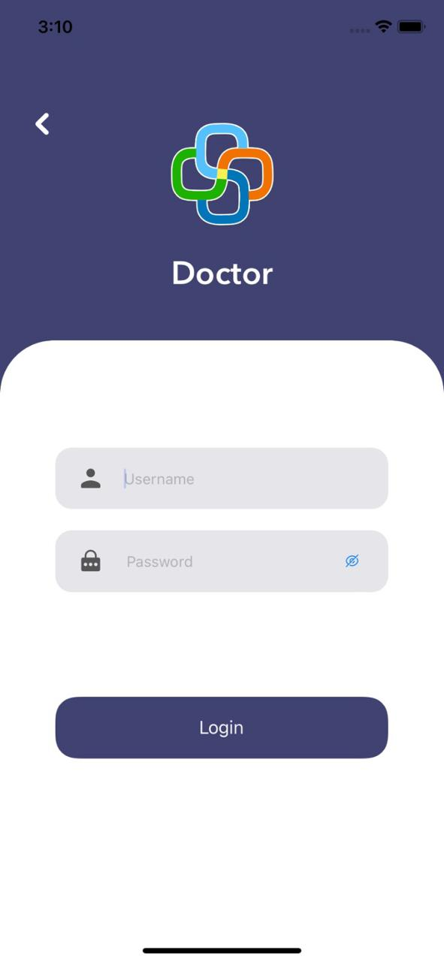
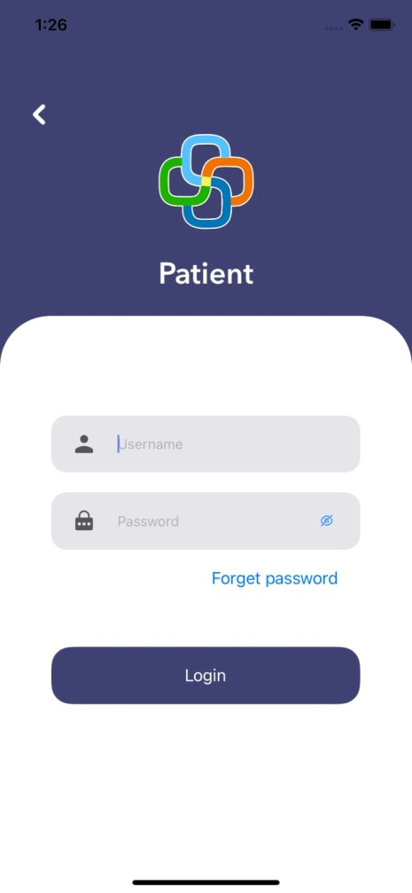
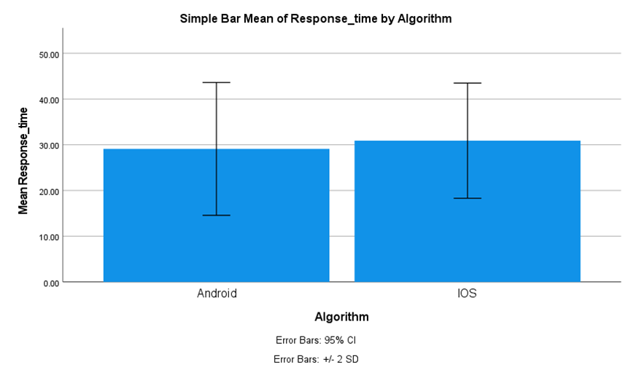
Name: Ms Nisha N Register Number: 192011495L
Guided by Dr T Suresh Balakrishnan
Ms. Poorani.S
Guided by Dr. Mary Valantina. G
Evaluation of Response Time Performance in Medication Reminder App: A Comparative Study Between iOS and Android Applications.
The Medication-Reminder is a comprehensive solution that uses voice app notification to remind patients to take their medications at the appointed times.
It enables smooth communication and effective progress tracking between medical professionals and patients. It improves the healing process for patients using tablets by offering precise scheduling and thorough progress tracking.
The aim of this project is to assess and contrast the navigation response times and user navigation durations experienced during the treatment process on both the Medication-Reminder Android application and the iOS platform.
We found that the iOS application had a faster navigation reaction time than the Android version when we evaluated which improves both user experience and operational effectiveness.
Therefore, this study serves as a critical step towards leveraging technology to enhance patient care and promote better health management through mobile medication-Reminder applications.
INTRODUCTION
Fig 1:Medication-Reminder
MATERIALS AND METHODS
MATERIALS AND METHODS
Retrieve User Data from the Database
Android Application
Android Application Process
Database – XAMPP(MySQL)
PHP- Visual Studio code.
Testing- Postman
Output- Android Studio
Creating URL for backend connection with database
Choose Application
Strategy
Analysis & Planning.
UI/UX Design.
App Development.
Testing.
Deployment & Support.
Develop and Test the Data
Calculating Response time
Data Collection Processing and measuring the data of sample size of N = 10, N = 10 Total = 20
iOS Application Process
Database – XAMPP(MySQL)
PHP- Visual Studio code.
Testing- Postman
Output- Swift Xcode
User inputs (GET/POST) for Structure Model &
backend connection
iOS Application
Compare the user data
v
RESULTS
Group Statistics
 | Algorithm | N | Mean | Std. Deviation | Std. Error Mean
Response time | Android | 10 | 29.1000 | 7.26407 | 2.29710
 | iOS | 10 | 30.9000 | 6.29727 | 1.99137
Comparision of Andriod and iOS Application in terms of Response Time. The Mean Recovery Rate of iOS is significantly higher than Android in Medication-Reminder.
UI responsiveness significantly impacts user satisfaction and perception of application performance.
If users experience delays or lag in the interface responsiveness, it can lead to frustration and dissatisfaction, regardless of the actual response time of the application.
Fig 2: Comparision of Andriod and iOS Application in terms of Response Time.
Fig 3:Admin Page
Fig 4:Doctor Login
Fig 5:Patient Login
DISCUSSION AND CONCLUSION
Based on T-test Statistical analysis, the significance value of p=0.007 (independent sample T - test p<0.05) is obtained and shows that there is a statistical significant difference between the group 1(iOS Application) and group 2(Android Application).
Overall, the Response time of the Medication-Reminder iOS Application is 29.33ms and it is better than the Android Application. The Android Application is 34.58ms.
From the work, it is concluded that the iOS Application attains the speed response time when comparing with Android Application in Medication-Reminder
Based on the statistical analysis and comparison of response times, prioritizing the optimization of the iOS version of Medication-Reminder is recommended to maintain its superior speed performance over the Android version, ensuring a seamless user experience.
This superior user experience on iOS could lead to higher user satisfaction ratings, increased retention rates, and potentially greater word-of-mouth recommendations, ultimately contributing to the overall success and popularity of the application.
BIBLIOGRAPHY
Abu-El-Noor, Nasser Ibrahim, Yousef Ibrahim Aljeesh, Bettina Bottcher, and Mysoon Khalil Abu-El-Noor. 2020. “Impact of a Mobile Phone App on Adherence to Treatment Regimens among Hypertensive Patients: A Randomised Clinical Trial Study.” European Journal of Cardiovascular Nursing: Journal of the Working Group on Cardiovascular Nursing of the European Society of Cardiology 20 (5): 428–35.
Curtis, Kristina, Anastasiya Lebedev, Elisa Aguirre, and Stephan Lobitz. 2019. “A Medication Adherence App for Children With Sickle Cell Disease: Qualitative Study.” JMIR mHealth and uHealth 7 (6): e8130.
Islam, Sheikh Mohammed Shariful, Vinaytosh Mishra, Muhammad Umer Siddiqui, Jeban Chandir Moses, Sasan Adibi, Lemai Nguyen, and Nilmini Wickramasinghe. 2022. “Smartphone Apps for Diabetes Medication Adherence: Systematic Review.” JMIR Diabetes 7 (2): e33264.
Kosse, Richelle C., Marcel L. Bouvy, Svetlana V. Belitser, Tjalling W. de Vries, Piet S. van der Wal, and Ellen S. Koster. 2019. “Effective Engagement of Adolescent Asthma Patients With Mobile Health–Supporting Medication Adherence.” JMIR mHealth and uHealth 7 (3): e12411.

